Slide 1
Tophat-Gaussian: “Check” Results
7 July 2020
P. Edwards, A. Weaver, P. Fulda
Max tophat mode order (4,8,12,16,20)
Perfect imaging
Review previous results (fixed meas. beam inputs)

Slide 2
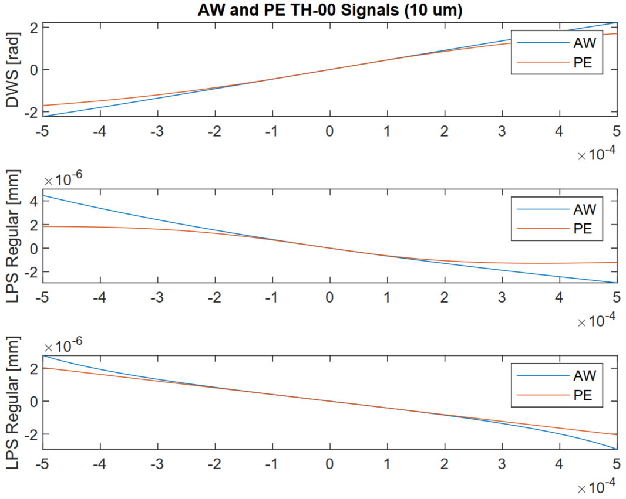
Parameter in PE meas. beam input incorrectly used old best-fit waist
Obviously no change for 00-00 results, but huge agreement here in valid region
Revised TH-HG00
(max mode order = 34)
DWS [rad]
LPS Regular [mm]
LPS Total [mm]

Slide 3
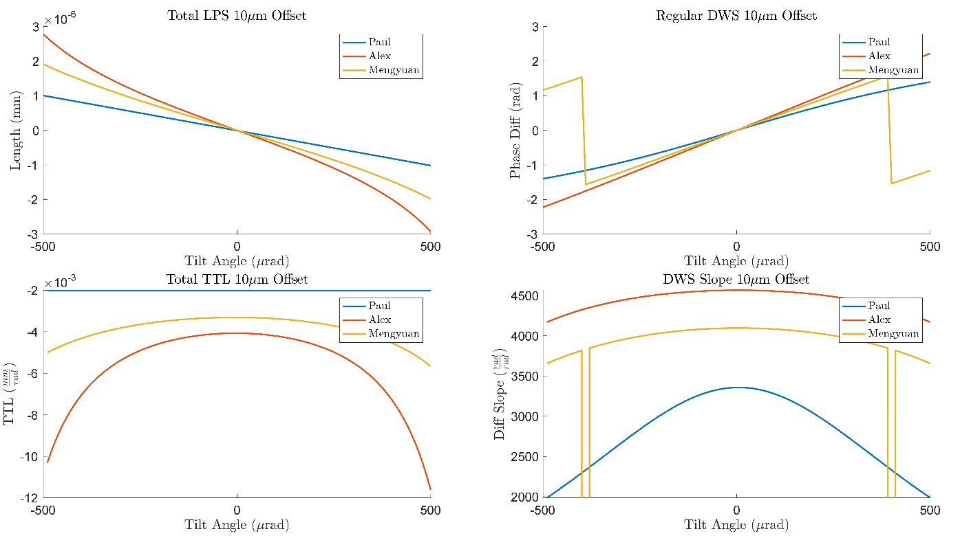
Previous TH-00 Results
Still expect some disagreement with Mengyuan

Slide 4
TH-HG00 Checks
Check mode-dependence: “Intermediate” max tophat mode orders (4,8,12,16,20)
10 um offset
10 mm to PD
1/3 mm BF waist tophat, 1mm HG00
Compare to back-of-envelope: Perfect imaging (0 mm to PD)
{-10,0,10} um offsets
1 mm tophat, 1mm HG00 sizes

Slide 5
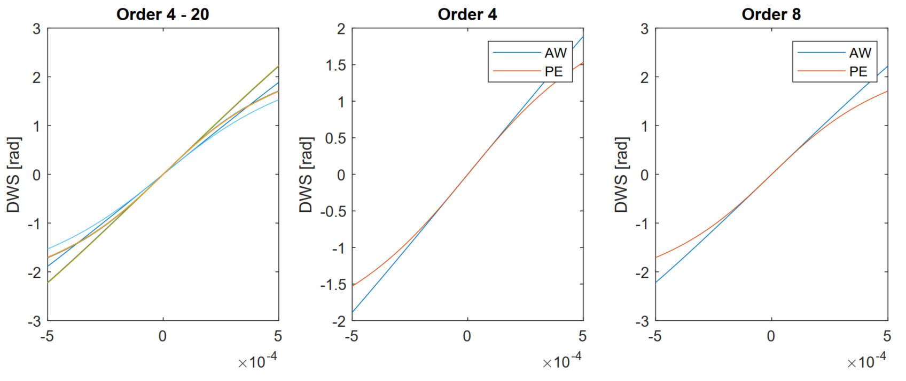
Max mode order
DWS
All signals appear to converge after order 4
Order 4 and 8 plots, assuming higher orders converge for AW & PE individually

Slide 6
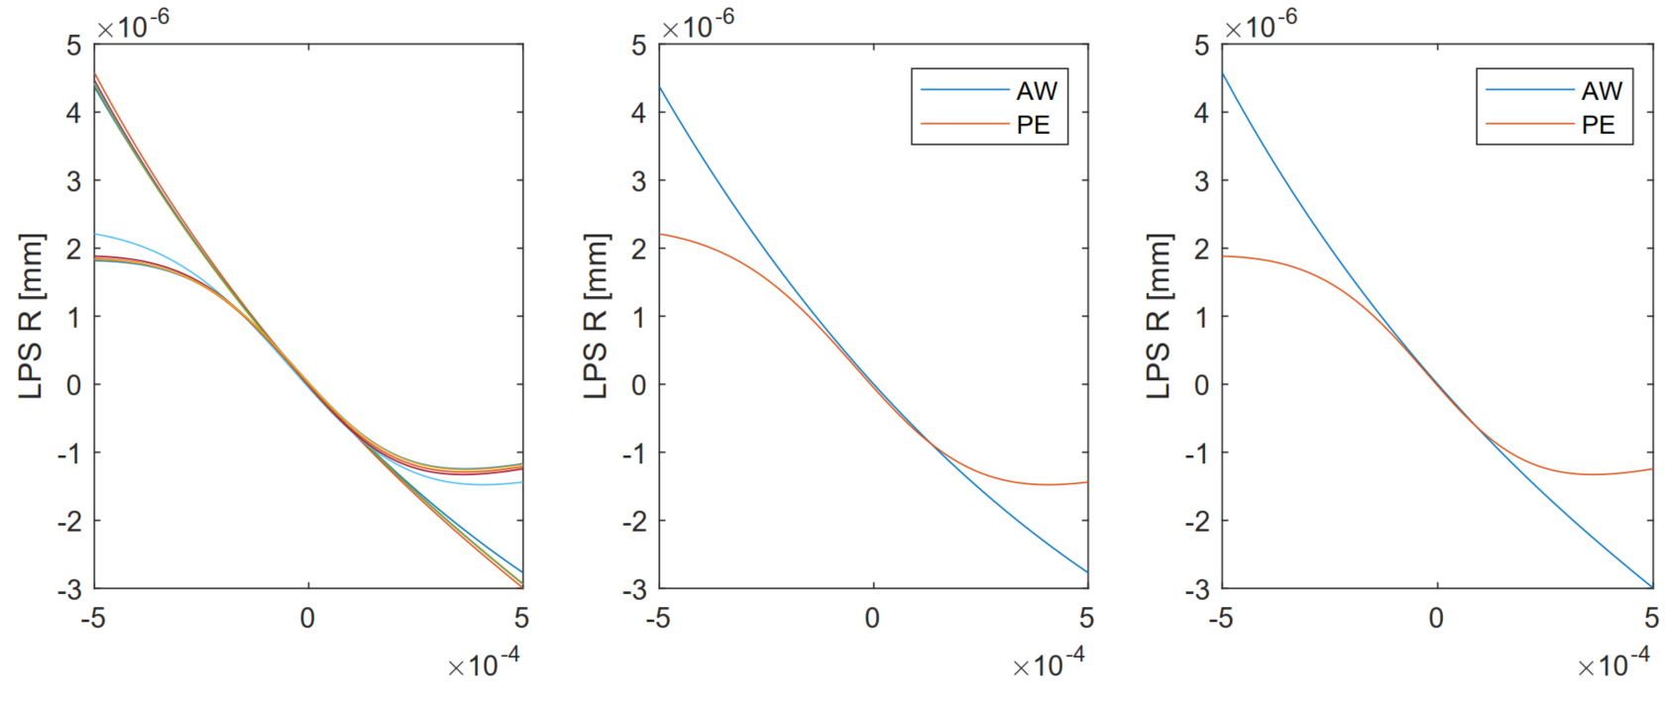
Max mode order
LPS
AW data for LPS total? (was order 10⁻³)

Slide 7
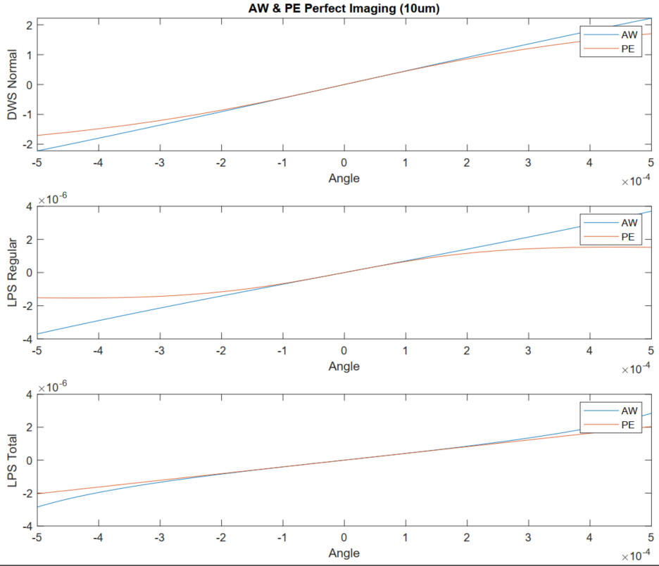
Perfect Imaging
AW & PE
AW initial results (explicit TH rotation) … DWS [rad], LPS [mm]

Slide 8
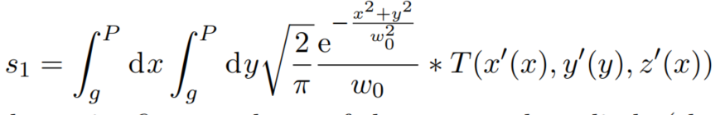
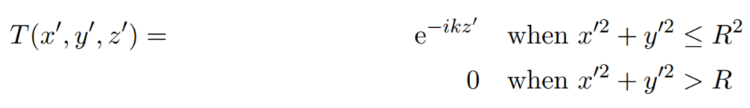
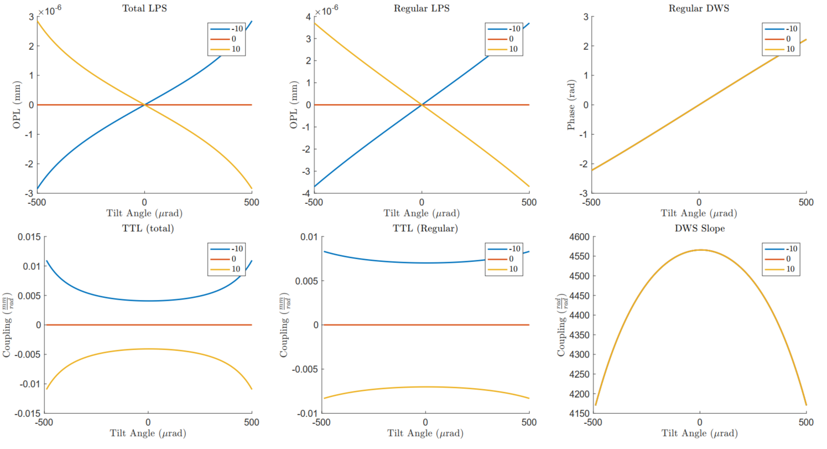
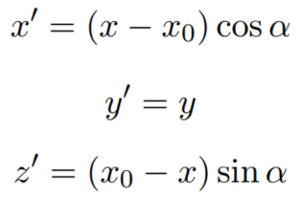
Perfect Imaging:
AW tophat function
Matches initial result
Tophat with primed coord’s
Coord. transformation error?

Slide 9

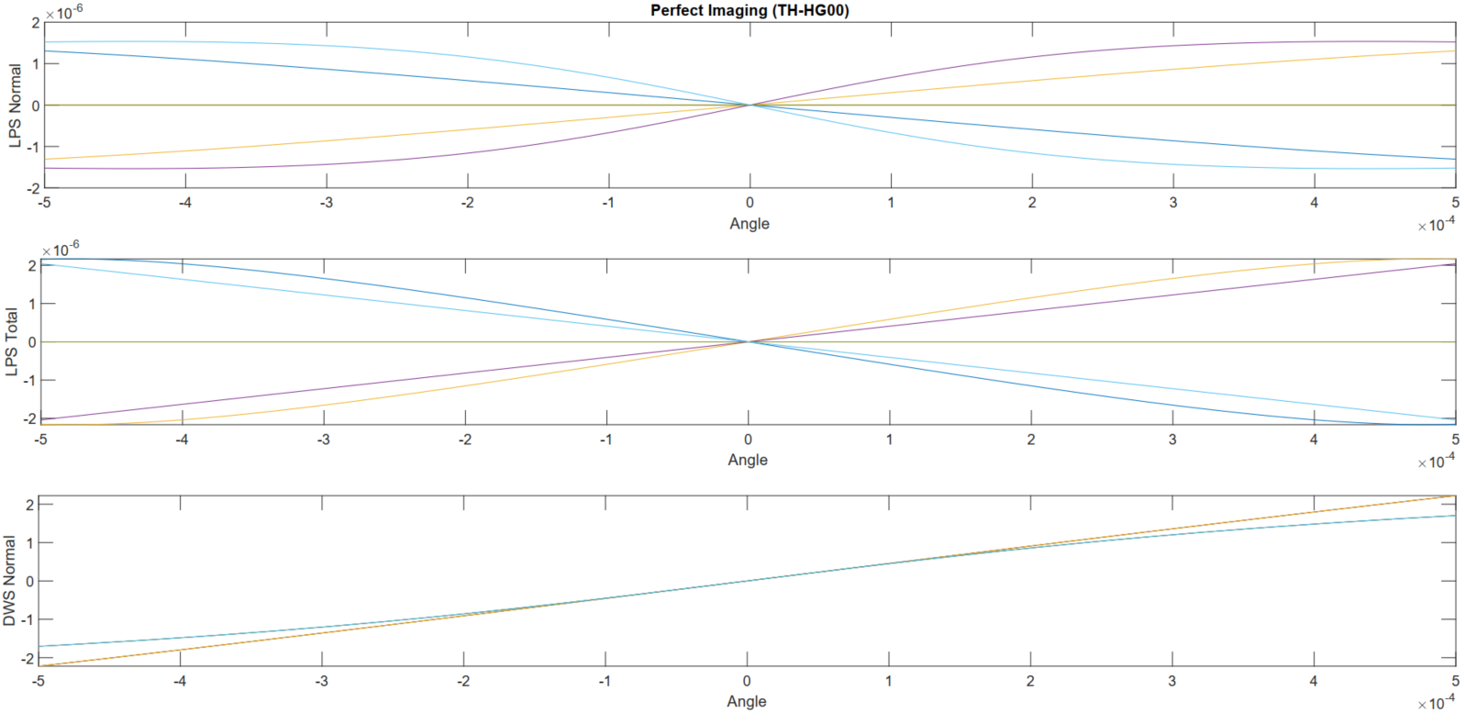
Perfect Imaging
PJF & PE
PJF & PE results
PE greater LPS magnitude/slopes
Offset mismatch?

Slide 10
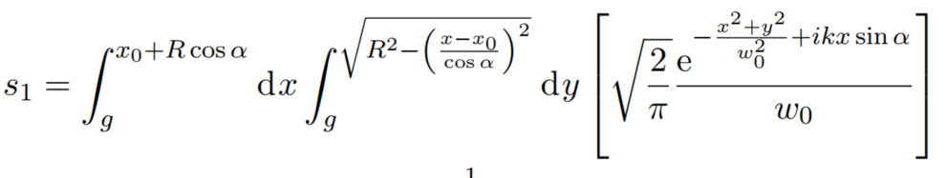
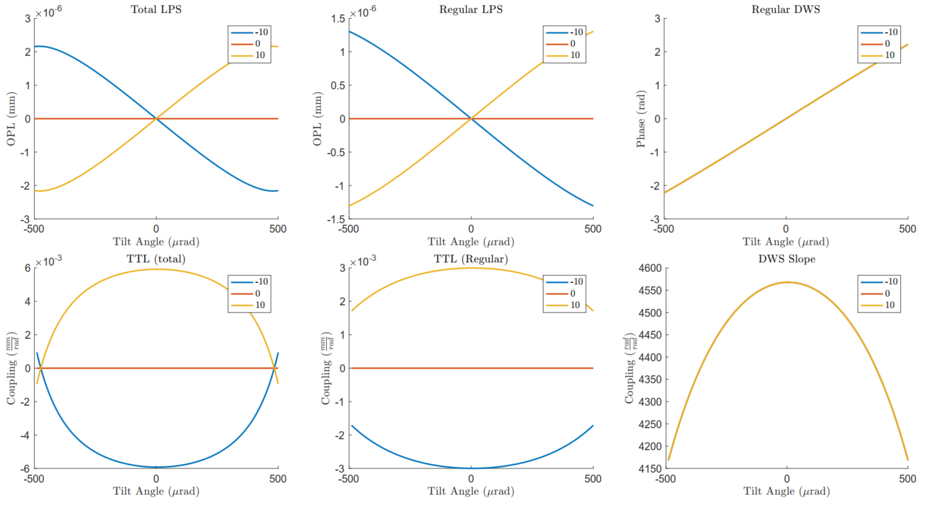

Perfect Imaging:
AW b.o.e.
Back of envelope:
Gaussian $×$ e^{ikxsinα}
Integration bounds
Closely matches pjf results

